Slide 1
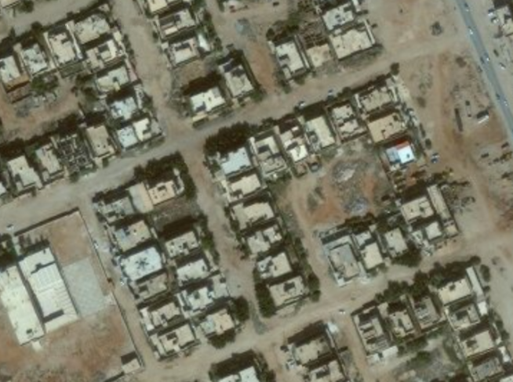

TARGET: SMITH JOE
UNCLASSIFIED (EXAMPLE)
3-I ID
NUMBER: UN5678 AREA: SPRINGBERG STREET: HOUSE:
Targeted by: 3-1 ID Area of Operations: FH 5-7 Trigger: HUMINT
DOI: 18 JAN 2014
TASK: DETAIN
GRID: 34S DA 18006 55717
PHYSICAL DESCRIPTION
Last given bed down grid for Joe Nobody is from 18 JAN 2014 IIR 13-DC-12-34-66-64
Sex: Male
Age: 45
Height: 5’10”
Body Comp: Heavy
Eyes: Brown
Hair: Brown
Other details: Has slight limp. Slightly obese and moves around slowly.
1
TARGET INFORMATION
Target Category: Criminal syndicate
Impact: Disrupt crime syndicate
Possible aliases: Unknown
Vehicle: Unknown
Family: Unknown
Religion: Unknown
STATUS:
PID:
✓
TARGET SUMMARY: Smith Joe is an international crime boss. He has been linked to several crime rings and has connections to terror cells.
Source:
✓
Location:
X
Intnl Cost:
✓
Source: HUMINT
Evidence:
✓
Trigger:
?
UNCLASSIFIED (EXAMPLE)
Last update with: HUMINT

